Slide 1

Fadllun A. A.
Hotel Booking
ANALYTIC
Data Cleaning - Exploring Data - Data Preprocessing - Predict Cancelation in hotel booking

Slide 2

CONTENTS
01
02
03
04
Hotel booking analysis
Hotel booking analysis
Model Prediction Result
Evaluation and Insights

Slide 3

INTRODUCTION
Important Point:
  Frequent Customers by Countries
  Movement or behavior of the customers
  Action that will affect the company
  Predicting Cancelation
  Model Evaluation and Explanation

Slide 4
Surveying the Counties
Top
We use top 10 countries that are frequent using our service to book hotels
COUNTRIES
Ins and Outs
Monitoring the top countries
Explore more about the customers of the top countries
What next?
Action that we take

Slide 5
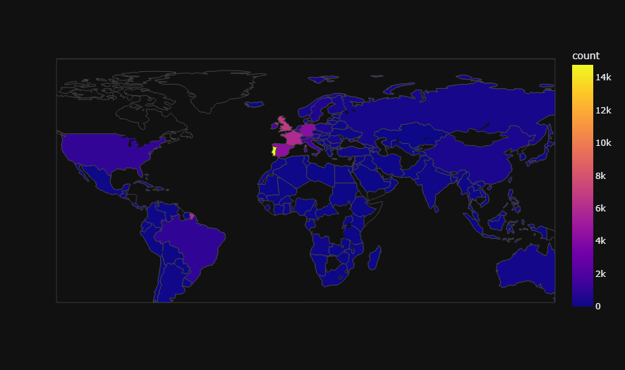
CUSTOMER DISTRIBUTION
Using Map plot
United Kingdom
Germany
France
Spain
Portugal

Slide 6
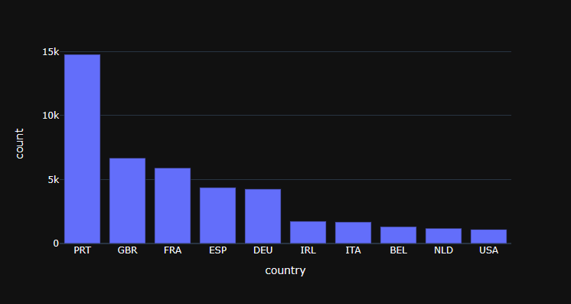
TOP COUNTRIES
Using Bar Chart
Countries initial using ISO 3166

Slide 7
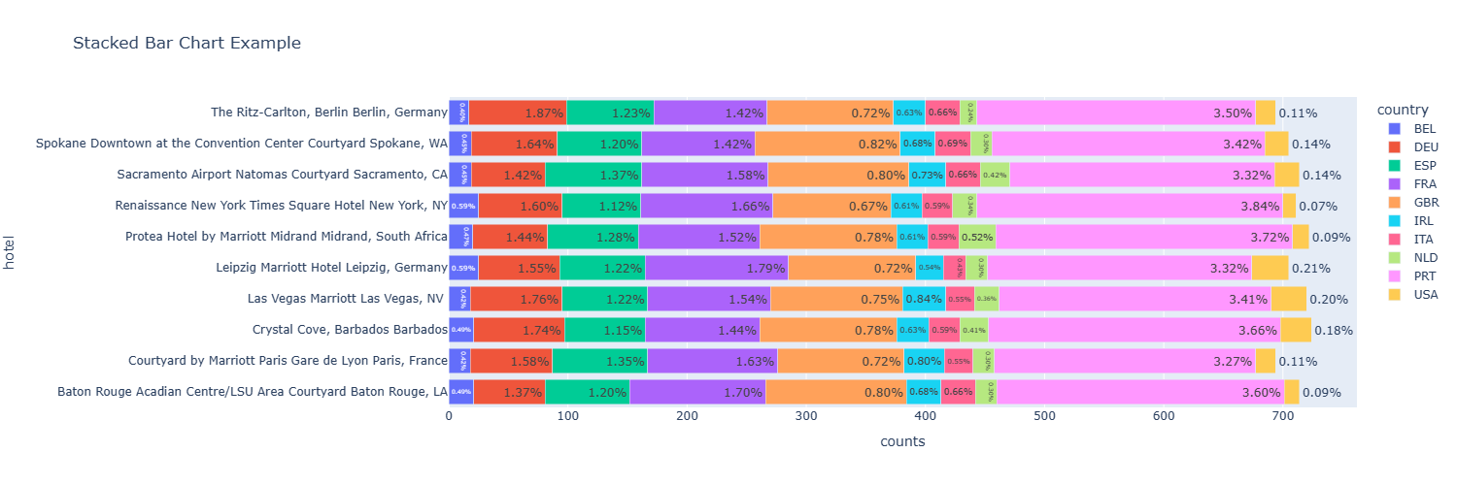
HOTEL FAVORITE
Using Stack Bar Chart
Contries and their fav destination
Belgium: New York, USA and Leipzig, Germany
France: Leipzig, Germany
Italia: Washington DC, USA
United State of America: Leipzig, Germany
Germany: Berlin, Germany
Great Britain: Washington DC, USA
Netherland: Midrand, South Africa
Spain: California, USA
Ireland: Nevada, USA
Portugal: New York, USA

Slide 8
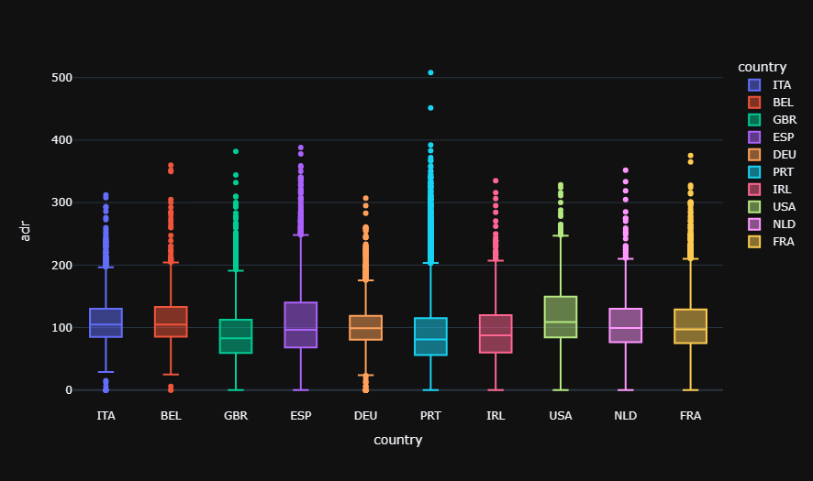
COUNTRIES ROOM PAYMENT
Using Stack Bar Chart

Slide 9
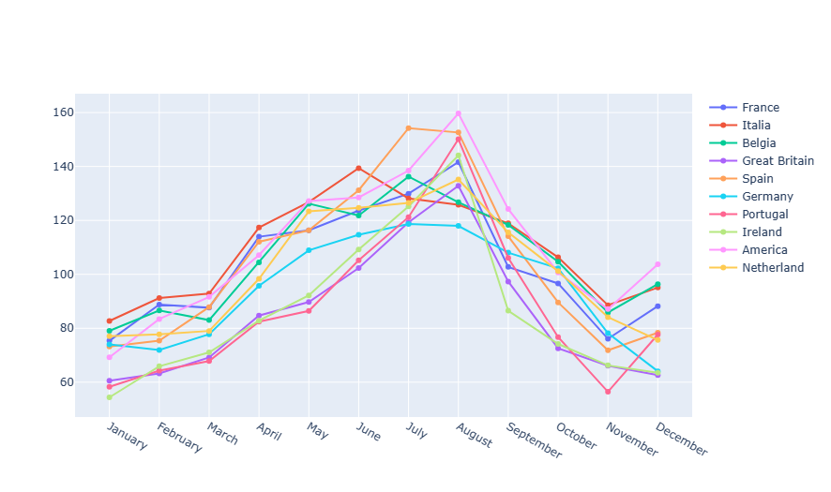
AVERAGE PAYMENT PER-ROOM
Using Stack Bar Chart

Slide 10
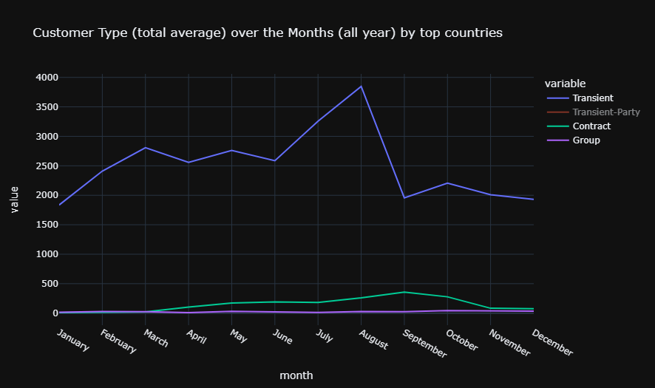
CUSTOMER TYPE
Using Stack Bar Chart

Slide 11
WHAT NEXT?
FINANCIAL MANAGEMENT
SURVEI TOP COMPANY AND AGENT
Control (When and Where)
3rd Parties effect
Investment (Promos & Partners)
Understanding our partners
NEXT MARKETING CAMPAING
UNDERSTANDING OTHER COUNTRIES
Traveling (Holiday)
Interest in Travel and Hotels
LEGEND
Parties Promos (Wedding / Birthday / Others)
Date and Times
Action
Planing
Target (Countries and Continent)
Consideration
Outcomes from our action
Strategic / Perfect Execution Times
Chance
SPONSORSHIP / ADS

Slide 12
ML WORKFLOW
DATA CLEANING AND FEATURE ENGINEERING
MODELLING WITH ML
TRAIN-TEST SPLIT
MODEL EVALUATION
Inputting data and start cleaning and feature engineering.
We split our data and choose which one is our feature and target
We choose our Machine Learning that fir or perfect as it needed.
We evaluate our ML to see if the prediction is on point or our ML is working fine.

Slide 13


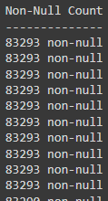
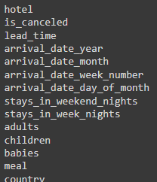
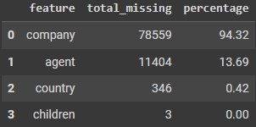
CLEANING STRATEGY
Information about the data
Dtype examination
Columns & Rows information
Null data information
Variables
Cannot be drop
Change to 0 instead
( 0 indicate as unidentified)

Slide 14
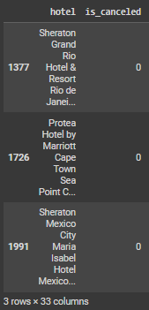
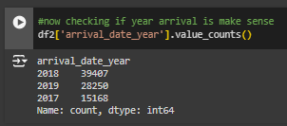
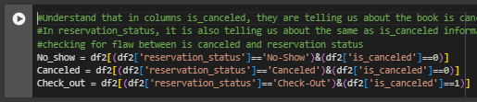
CLEANING + BUSINESS UNDERSTANDING
Combination of cleaning as a data science and cleaning as a business
Checking for customer
Checking if the year was out of bounds
No Problem Found
Checking reservation stats and canceled is in the same meaning
No Problem Found

Slide 15


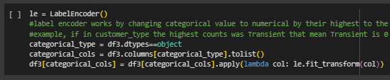

FEATURE SELECT AND EDIT
What will our model consume

Slide 16

MODELING
Best Model for Prediction
Test
Train
82.13%
99.26%
86.21%
99.26%
Tree Base
81.68%
82.41%
83.60%
85.04%
84.51%
86.58%
83.37%
89.88%

Slide 17
EVALUATE RESULTS OF THE MODELS
Accuracy of all models
Decision Tree
Random Forest
Light Gradient Boost
Precision
Recall
F1
Precision
Recall
F1
Precision
Recall
F1
0.86
0.86
0.86
0.86
0.93
0.89
0.86
0.88
0.87
0.76
0.76
0.76
0.86
0.75
0.80
0.79
0.75
0.77
CAT Boost
XG Boost
Gradient Boost
Precision
Recall
F1
Precision
Recall
F1
Precision
Recall
F1
0.85
0.92
0.88
0.83
0.93
0.88
0.80
0.93
0.86
0.84
0.72
0.78
0.85
0.68
0.75
0.85
0.62
0.72

Slide 18
SUMMARY
  Basic tree model like decision tree has overfitting because their training model accuracy is higher than testing accuracy
  Fixing with bagging technique like random forest still has overfitting, but with booster technique model is manage to overcome the overfitting.
  CAT Booster, has good precision and recall values among other booster models.
  Data analysis leads to a marketing campaign plan for the following year.
  Targeted can help attract customers to recommend and repeat their journey again the following year.
  The results of the campaign can be used as further analysis for B2B plans for agents and companies.
  The campaign results also analyze whether there is an impact on minority countries.
  CAT Booster is the best model among other models for predicting cancelation
  To increase accuracy, use cross validation for hyperparameter tuning.

Slide 19
Fadllun A. A.
Thank you

